Slide 1
MuleSoft CloudHub Architecture - Infra
May 2021

Slide 2
CloudHub Architecture – Infrastructure Perspective
AWS Regions
Choice of Regions
Single vs Multi
VPC
VPC Connectivity
Load Balancer
Workers
Single worker will not support HA
Multiple worker will support HA
Single Region Multi Worker
Multi Region Multi Worker

Slide 3


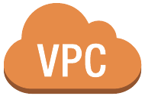

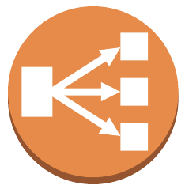



CloudHub Worker Perimeters
4
11
Host Platform
Anypoint VPN can create a secure connection between your Anypoint Virtual Private Cloud (VPC) and your on-premise network (intranet)
Each AMI is associated with a customer security group
AWS Xen Hypervisor
6
8
A Mule application can employ a variety of authentication mechanisms (e.g., mutual SSL, OAuth, JWT, ...) for greater security
Anypoint Virtual Private Cloud (VPC) allows customers to create a virtual, private, and isolated network segment
Mule Customized AMI
Mule Runtime
7
The Mule runtime has an embedded API gateway which can execute API policies to govern access to the API
Mule API Gateway
10
Mule API
A VPC can add one or more dedicated load balancers to further control access to resources
3
The Mule runtime executes as an unprivileged user on the host and only executes a single application
1
2
Each customer application in CloudHub is deployed to its own dedicated virtual host.
Each CloudHub instance employs a heavily customized and pruned AMI devoid of all unnecessary packages and services.
Images are continually scanned for known vulnerabilities and applications are periodically redeployed to ensure they are executing on hosts with the latest, most up to date, OS and packages.
9
Each VPC has its own firewall to gate inbound access
5
An AWS firewall is implemented in the hypervisor to gate network traffic
3

Slide 4





A VPC can have a maximum of 64K IP addresses
Virtual Private Cloud (VPC)
A logical segmentation of your CloudHub worker IP network*
Region
A VPC can span up to 4 Availability Zones
A IPv4 IP address is 32-bits long
A VPC is created with-in an AWS Region
Availability Zone 1
Availability Zone 2
Availability Zone 4
Minimum segmentation** of a VPC is a 24-bit subnet (e.g., 10.1.1.0/24) for an availability of 256 IP addresses.
Production VPC - [10.1.1.0/24]
A VPC must have minimum of 256 IP addresses
Maximum segmentation of a VPC is a 16-bit subnet (e.g., 10.1.0.0/16) for availability of 64K IP addresses.
A private, fault-tolerant and secure network for hosting your CloudHub workers.
Mule Worker
Mule Worker
Mule Worker
Each VPC has its own firewall to gate access
Each VPC has its own firewall to gate access
Non-Production VPC - [10.1.0.0/16]
A VPC can span across a maximum of 4 availability zones
Facilitates the extension of a corporate network and allows CloudHub workers to access secure resources behind a corporate firewall.
Mule Worker
Mule Worker
Mule Worker
* See Appendix A for more details on IP addressing
** Not recommended for Production

Slide 5






VPN Connectivity Options
There are 3 primary methods for connecting an Anypoint VPC to on-premises/customer managed data centers:
VPC peering to an AWS VPC within the same AWS region as the Anypoint VPC
AWS Direct Connect
Secured VPN Connection**
Each VPC has its own VGW (Virtual Private Gateway)
A VGW can support up to 10 VPN connections
A VGW can support a maximum throughput of 1.25 Gbps (bandwidth is shared across all VPN connections terminating on a VGW)
** Most commonly used connectivity option between a VPC and customer managed data centers
Corporate Data Center
Make sure VPC IP address range does not overlap with on-premise IP addresses
Secure Zone
Production VPC - [10.100.1.0/24]
Anypoint VPN Connection
Firewall
Virtual
Private
Gateway
Customer Gateway
Mule Worker
Mule Worker
Mule Worker
Each VPN connection supports two IPSec tunnels in an active/passive config
Each VPN gateway must expose a public IP address

Slide 6
Virtual Private Network (VPN)
An Anypoint VPN provides a secure, private connection between your MuleSoft Virtual Private Cloud (VPC) and your on-premises network.
A VPN allows you to extend your corporate network to include your VPC
A VPN allows CloudHub workers and corporate systems to seamlessly communicate using private IP addresses
A VPN can only be associated to a single VPC
A Virtual Private Gateway (VGW) terminates the VPN connection on the MuleSoft side
Each VPC has its own VGW
A VGW can support up to 10 VPN connections
The number of VPNs you can create depends on the VPN entitlements available to your account.
A VGW can support a maximum throughput of 1.25 Gbps
Bandwidth is shared across all VPN connections terminating on a VGW
Each VPN connection supports two IPSec tunnels in an active/passive config

Slide 7
Anypoint VPN Architecture
2
Add static routes to the VPN configuration for all destination networks and/or hosts
Static Routes
10.12.190.21/32
10.12.190.22/32
10.10.29.13/32
10.23.3.0/24
Host routes to the DNS Servers
Host route to a specific back-end system
Corporate Data Center
DNS Servers
Secure Zone 1
Network route to the 10.10.3.0/24 network in Secure Zone 1
[10.10.3.0/24]
Make sure VPC IP address range does not overlap with on-premise IP addresses
[10.12.190.21]
[10.12.190.22]
Firewall
vpc-10-100-1-0-24 [10.100.1.0/24]
Anypoint VPN Connection
[3.85.69.183] - Tunnel 1
[3.223.106.38] - Tunnel 2
Secure Zone 2
Virtual
Private
Gateway
1
Customer Gateway
Mule Worker
Mule Worker
Mule Worker
[10.10.29.0/24]
Each VPN connection supports two IPSec tunnels in an active/passive config
[51.34.57.115]
Each VPN gateway must expose a public IP address
4
Firewall
Add IP addresses of Internal DNS servers to the VPC configuration associated with this VPN
Internal DNS IPs
10.12.190.21
10.12.190.22
3
Internal Domains to Resolve
abc.net
subdomain.abc.com
Add domains to be resolved by the Internal DNS servers
[10.10.29.13]
7

Slide 8
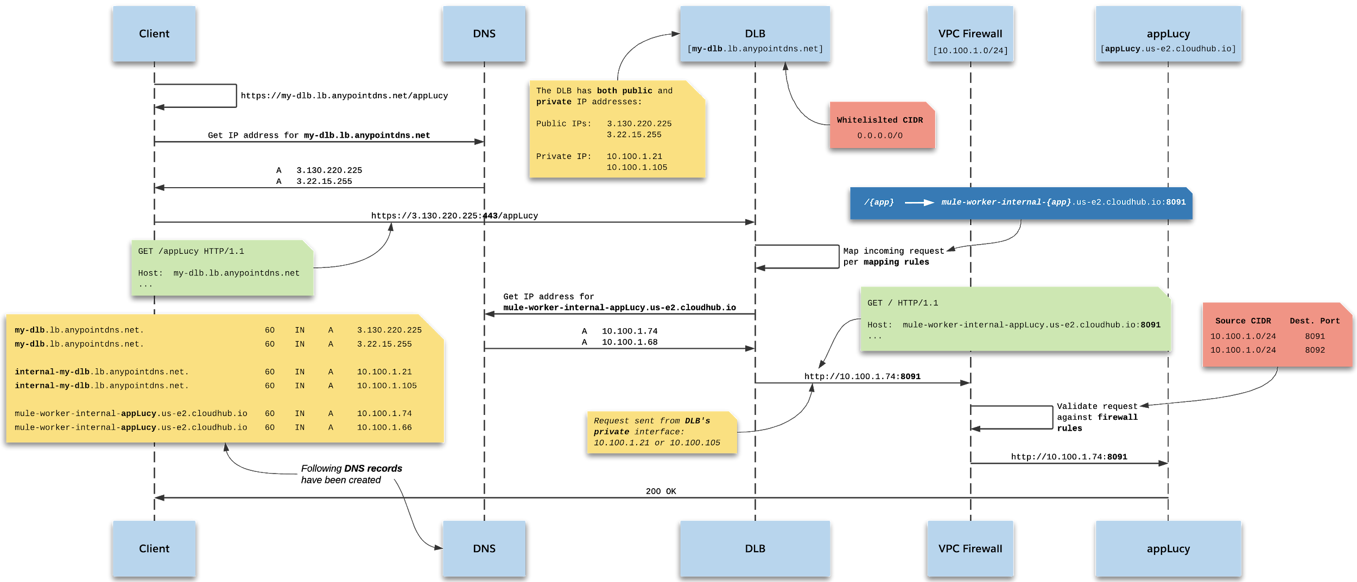
Sequence Diagram - Single DLB

Slide 9
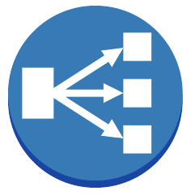


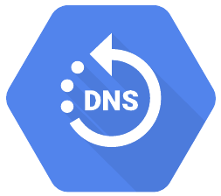
Dedicated Load Balancer Architecture
my-dlb.lb.anypointdns.net/appLucy |  | mule-worker-internal-appLucy.us-e2.cloudhub.io:8091
my-dlb.lb.anypointdns.net/appEthel |  | mule-worker-internal-appEthel.us-e2.cloudhub.io:8092
[cloudhub.io]
CloudHub Domain Name
Region
[us-e2]
AWS Region
4
Default mapping rules for the Dedicated Load Balancer
Customer VPC [10.100.1.0/24]
HTTP/S
Client
Dedicated Load Balancer
[my-dlb.lb.anypointdns.net]
6
https://my-dlb.lb.anypointdns.net/appLucy
appLucy
appLucy
appEthel
7
Shared Load Balancer
[us-e2.cloudhub.io]
Mule Worker
Mule Worker
Mule Worker
http://appLucy.us-e2.cloudhub.io
FQDN for the apps the same as in SLB architecture.
DNS entries are similar as in SLB architecture, except internal addresses will be from the 10.100.1.0/24 pool.
5
Default mapping rules for the Shared Load Balancer
appLucy.us-e2.cloudhub.io:80 |  | mule-worker-appLucy.us-e2.cloudhub.io:8081
appEthel.us-e2.cloudhub.io:443 |  | mule-worker-appEthel.us-e2.cloudhub.io:8082
1
3
2
Default firewall rules for the customer VPC
DNS records for the Dedicated Load Balancer
Standard FQDN template for the DLB
Source CIDR | Dest. Port
10.100.1.0/24 | 8091
10.100.1.0/24 | 8092
0.0.0.0/0 | 8081
0.0.0.0/0 | 8082
my-dlb.lb.anypointdns.net. | 60 | IN | A | 3.130.220.225
my-dlb.lb.anypointdns.net. | 60 | IN | A | 3.22.15.255
internal-my-dlb.lb.anypointdns.net. | 30 | IN | A | 10.100.1.21
internal-my-dlb.lb.anypointdns.net. | 30 | IN | A | 10.100.1.105
<lb_name>.lb.anypointdns.net
my-dlb.lb.anypointdns.net

Slide 10


Multiple Dedicated Load Balancers Architecture
[cloudhub.io]
Region
[us-e2]
1
All applications within the VPC should be exposed on either port 8091 for HTTP or 8092 for HTTPS
All applications have internal addresses from the 10.100.1.0/24 pool.
Customer VPC [10.100.1.0/24]
Source CIDR | Dest. Port
10.100.1.0/24 | 8091
10.100.1.0/24 | 8092
Exp. API
Process API
System API
Mule Worker
Internal/Private DLB
[int-dlb.lb.anypointdns.net]
Mule Worker
Mule Worker
Shared DLB
[us-e1.cloudhub.io]
2
Firewall rules for the customer VPC to allow traffic from only within the VPC
Exp. API
Process API
System API
Mule Worker
Mule Worker
Mule Worker
Exp. API
Process API
System API
External/Public DLB
[ext-dlb.lb.anypointdns.net]
3
Mule Worker
5
Mule Worker
Mule Worker
Default mapping rules for each DLB
Process requests only from VPC addresses
4
Whitelisted CIDR
0.0.0.0/0
Whitelisted CIDR
10.100.1.0/24
Process requests from anywhere
/{app} |  | mule-worker-internal-{app}.us-e2.cloudhub.io:8091

Slide 11
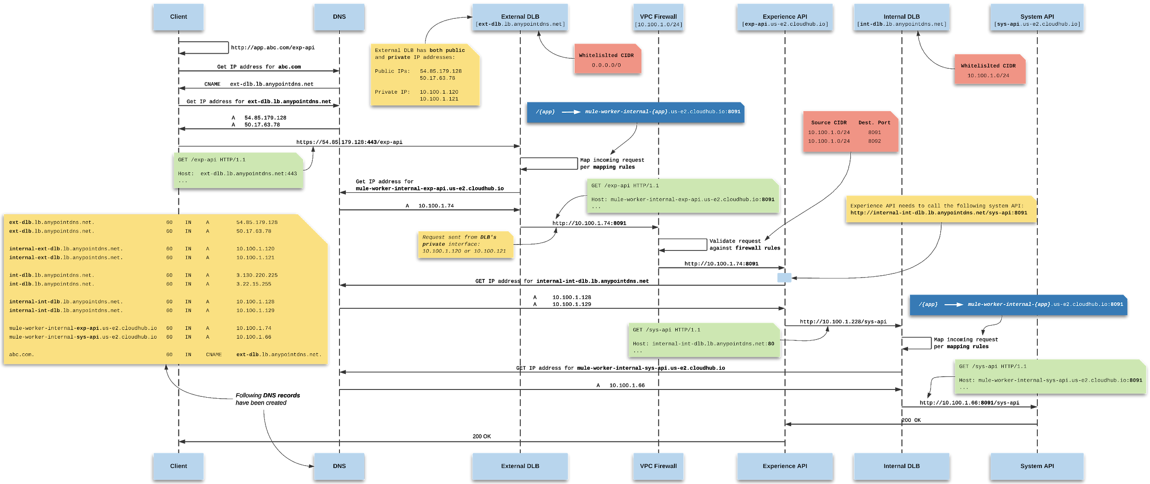
Sequence Diagram - Multiple DLBs
11

Slide 12
Architecture Decision points
Decision Points | Supported Options | Recommended options | PSEG’s decision | Comments
Region | Single Region Multi Region | Be in sync with PSEG’s AWS impl. and/or security requirements | Single Regions | PSEG’s AWS impl. is single regions and it meets their security needs
Choice of regions | https://docs.mulesoft.com/runtime-manager/cloudhub-networking-guide#regional-services | Be in sync with PSEG’s AWS impl. and/or security requirements | US East | PSEG’s AWS impl. Is in US East
VPC | Single Multiple | Multiple | Multiple | We recommend a minimum of 2 VPC(1 for prod & 1 for non prod)
VPC Connectivity | VPN AWS Peering AWS Direct Connect | Based on PSEG’s requirements & Infrastructure supported by customer | VPN | Based on current LI infrastructure VPN is chosen. There is a desire to move to Direct Connect
Load Balancer | Share Load Balancer Single Dedicated Load Balancer(DLB) Multiple Dedicated Load Balancer (DLB) | Based on PSEG’s requirements | Single Dedicated Load Balancer | If recommend a minimum single DLB, if the customers has many customer facing APIs and security segregation requirements we recommend multiple DLB

